Slide 1
PAYROLL FLOWCHART

Slide 2
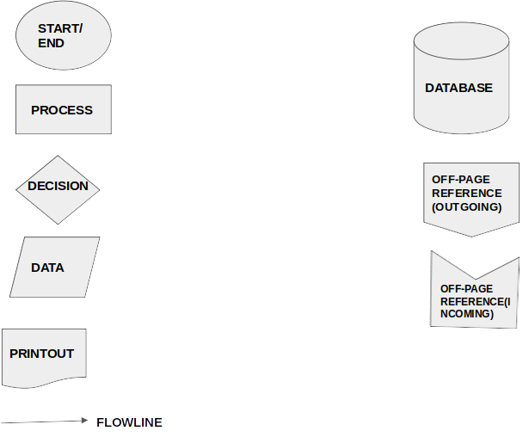

Slide 3
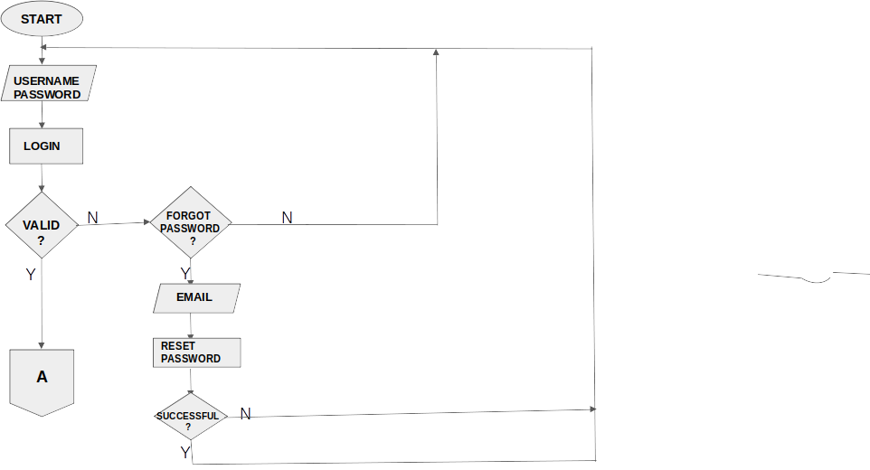
OPERATION

Slide 4
A
MANAGE
PAYROLL
?
N
B
A
Y
N
N
N
SOFT
DELETE
?
CREATE
PAYROLL
?
VIEW
PAYROLL
?
UPDATE
PAYROLL
?
Y
Y
Y
Y
HOURS WORKED,
OVERTIME,
PAYRATE
HOURS WORKED,OVERTIME,PAY RATE
SOFT
DELETE
EMPLOYEE DETAILS,STATUS,PAY RATE
QUERY
DATA
UPDATE
CREATE
PAYROLL
MANAGE
VIEW
PAYROLL
MANAGE
C

Slide 5
B
MANAGE
PAYSLIP
?
N
D
A
Y
N
N
N
CREATE
PAYSLIP
?
VIEW
PAYSLIP
?
UPDATE
PAYSLIP
?
SOFT
DELETE
?
Y
Y
Y
STATUS,DATES,
DAYS
UPDATE
SOFT
DELETE
ENTER EMPLOYEE DETAILS,PAY PERIOD
QUERY
DATA
CREATE
PAYSLIP
MANAGE
VIEW
PAYSLIP
C

Slide 6
D
MANAGE
SALARY
?
N
A
E
Y
PROCESS
GROSSPAY
?
N
N
N
VERIFY
SALARY
?
PROCESS
NET PAY
?
N
N
VIEW
SALARY
?
PAY
EMPLOYEE
?
Y
Y
Y
Y
Y
Y
ENTER PAYMENT TYPE
HOURS WORKED,
OVERTIME
VERIFY
NETPAY
ENTER EMPLOYEE DETAILS,HOURS WORKED,OVERTIME
N
UPDATE
GROSSPAY
PAY EMPLOYEE
QUERY
DATA
VIEW
SALARY
VIEW
PAYSLIP
C

Slide 7
N
E
VIEW
REPORTS
?
F
Y
VIEW
REPORTS
?
N
PRINT
REPORTS
?
N
Y
Y
QUERY
DATA
PRINT
REPORTS
REPORTS
VIEW
REPORTS
C

Slide 8
F
E
CHANGE
PASSWORD
?
N
Y
OLD PASSWORD
NEWPASSWORD
REPEAT PASSWORD
CHANGE
PASSWORD
N
SUCCESSFUL
N
LOGOUT
C

Slide 9
C
OPERATION
DATABASE
Y
Y
Y
Y
Y
N
LOGOUT
?
Y
LOGOUT
LOGIN
N
EXIT
?
Y
END

